Slide 1



RF
RECIPE FUSION
PRESENTED BY:
Tayyaba Ejaz - 2751
Laiba Hassan - 2769

Slide 2
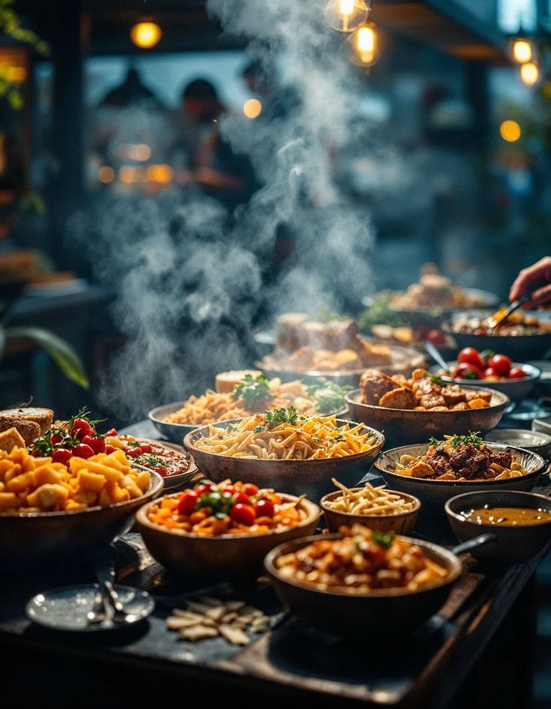
TABLE OF CONTENT
Introduction
Objectives
Dashboards
SDG Goals

Slide 3
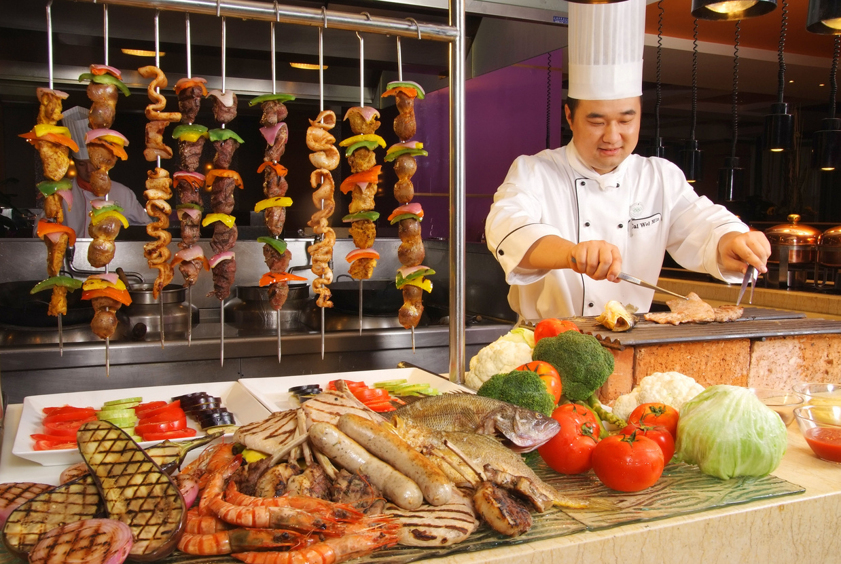
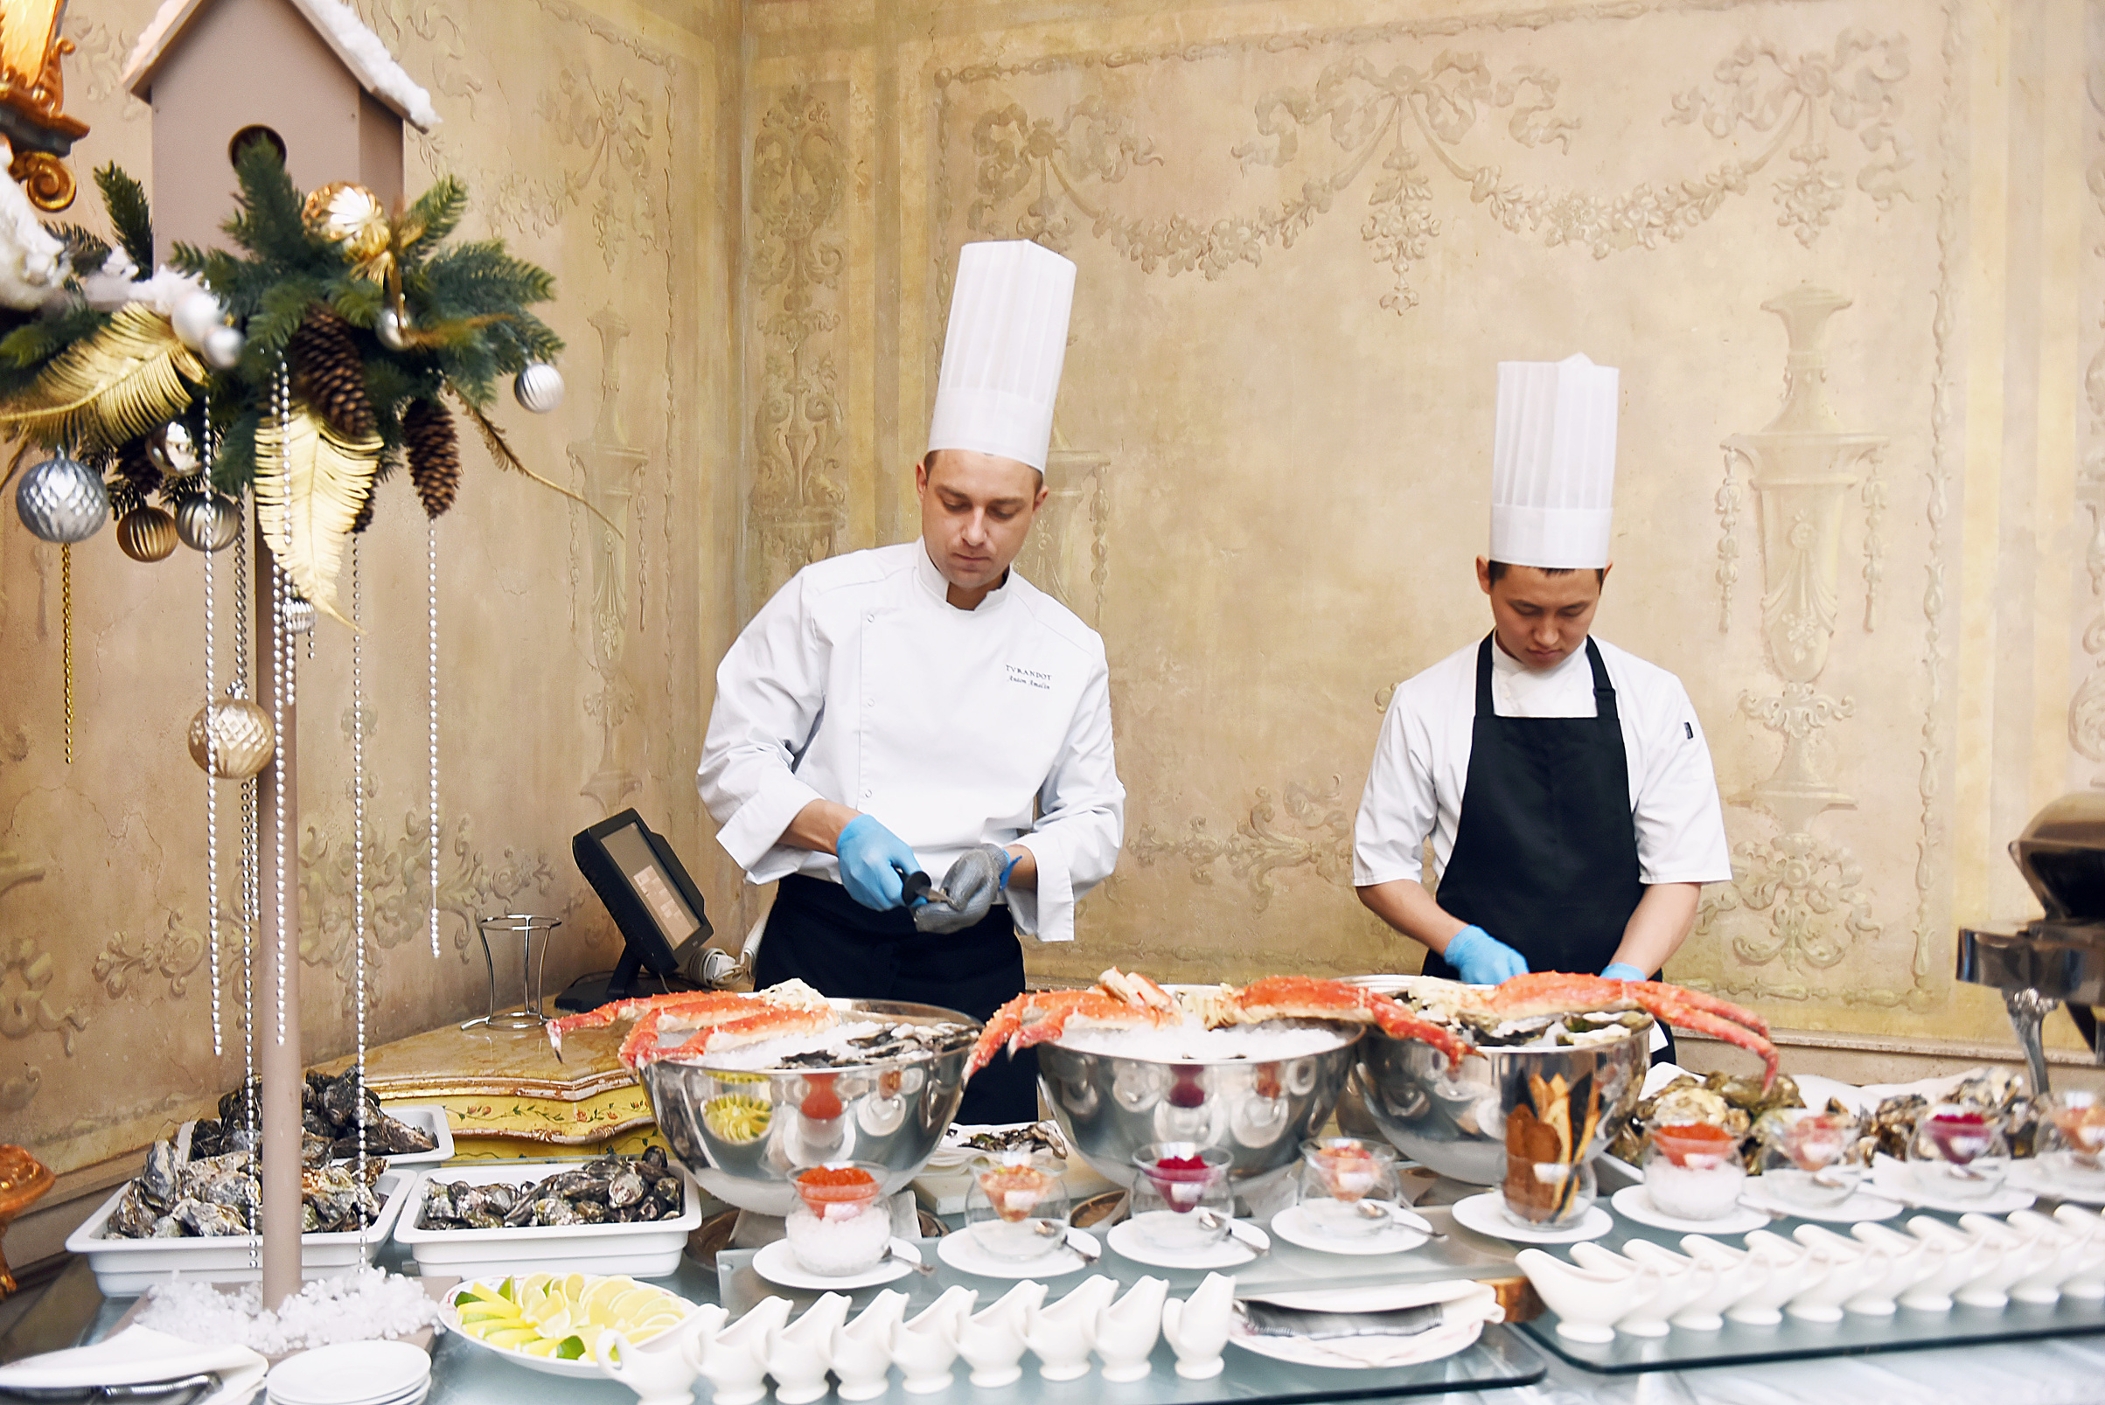

INTRODUCTION
A smart recipe recommendation platform that helps users cook delicious, personalized meals using ingredients they already have
Built on the MERN stack (MongoDB, Express, React, Node.js), the platform intelligently matches your available ingredients and dietary preferences—whether vegan, gluten-free, or whole food plant-based—to curated recipes
It reduces food waste, promotes healthier eating habits, and saves time in meal planning.

Slide 4
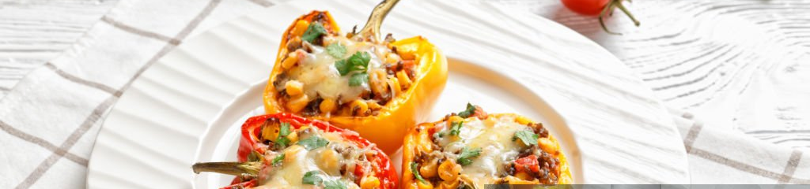



objectives
Real time ingredient based search and filtering
Personalized recommendations based on user behavior
Generating Personalized Meal Planner for whole week
Accessibility and mobile responsiveness for ease of use

Slide 5







System architecture
User Controls
Register/Login: Create an account and access personalized features.
Search Recipes: Find recipes by name or by available ingredients.
Apply Filters: Narrow down results based on diet, cuisine, or preferred difficulty time.
Recipe Recommendations: Get AI-based suggestions based on search history or preferences.
Save a Recipe: Bookmark recipes for future reference.
Add Reviews: Provide feedback and ratings on tried recipes
Meal Plan: User can generate meal plan for a whole week

Slide 6

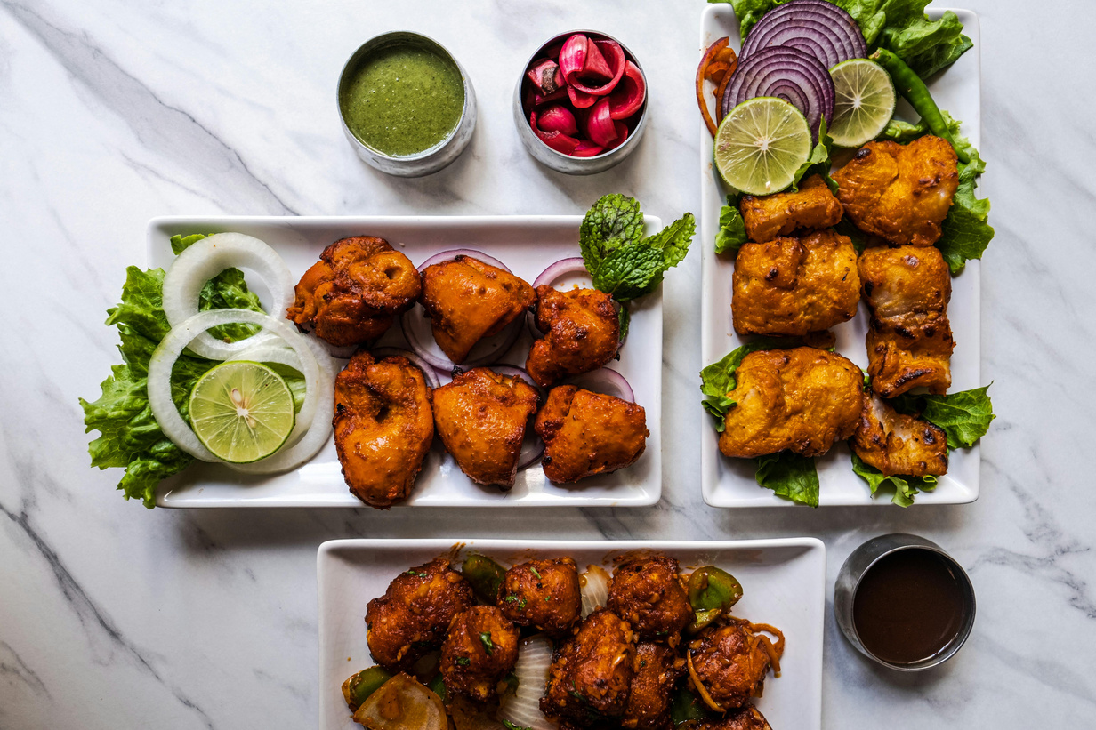
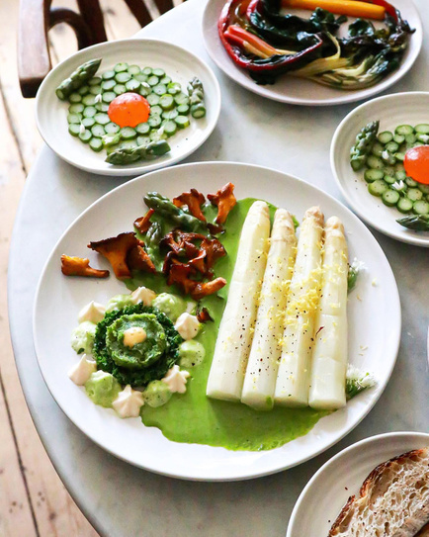
System architecture
Admin Controls
View Users: Access a list of all registered users.
Edit/Update User: Modify user profiles.
Delete User: Remove a user account from the system.
View Reviews: Monitor user-generated feedback on recipes.
Delete Reviews: Remove offensive or irrelevant reviews.
Record of Search History: Track what users are searching to improve recommendations.
Various Types of Recipes

Slide 7
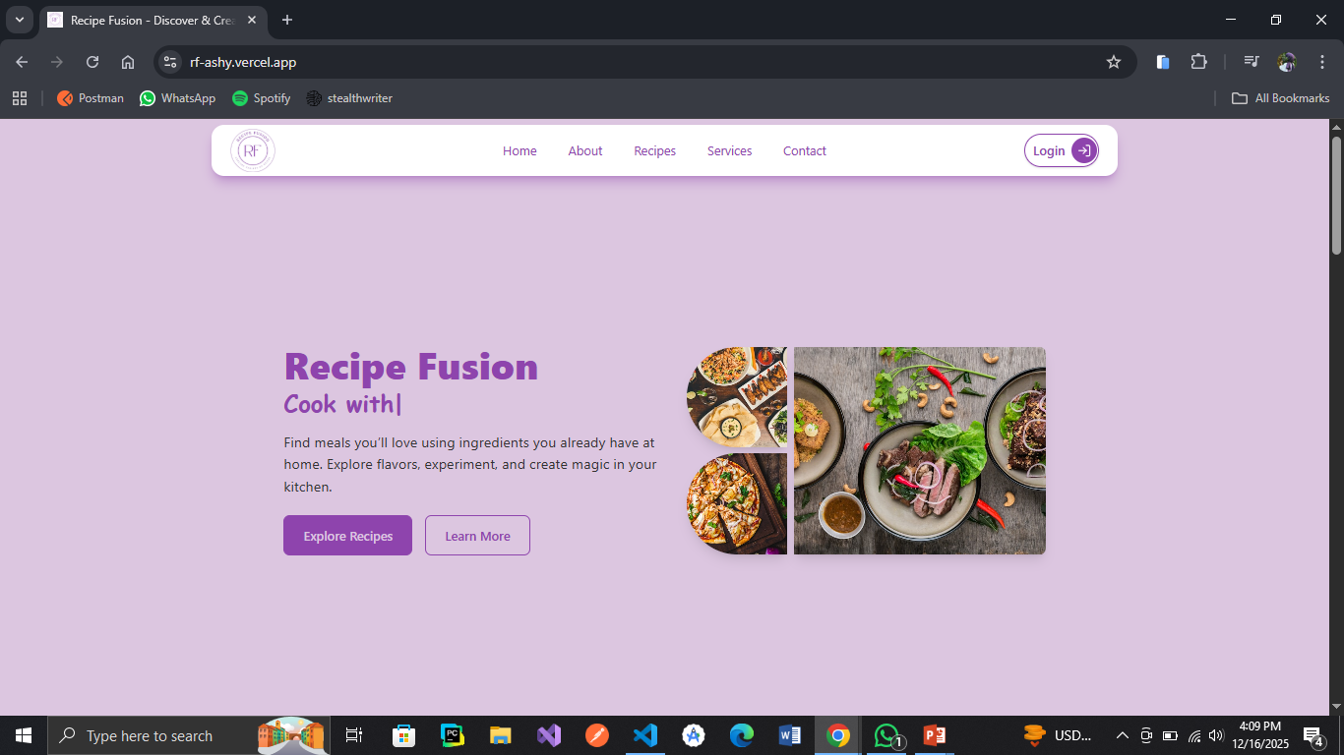
Landing Page
Hero Section
This is my hero section where the user is having a short intro to our website and user can explore recipes and go to the about section too

Slide 8
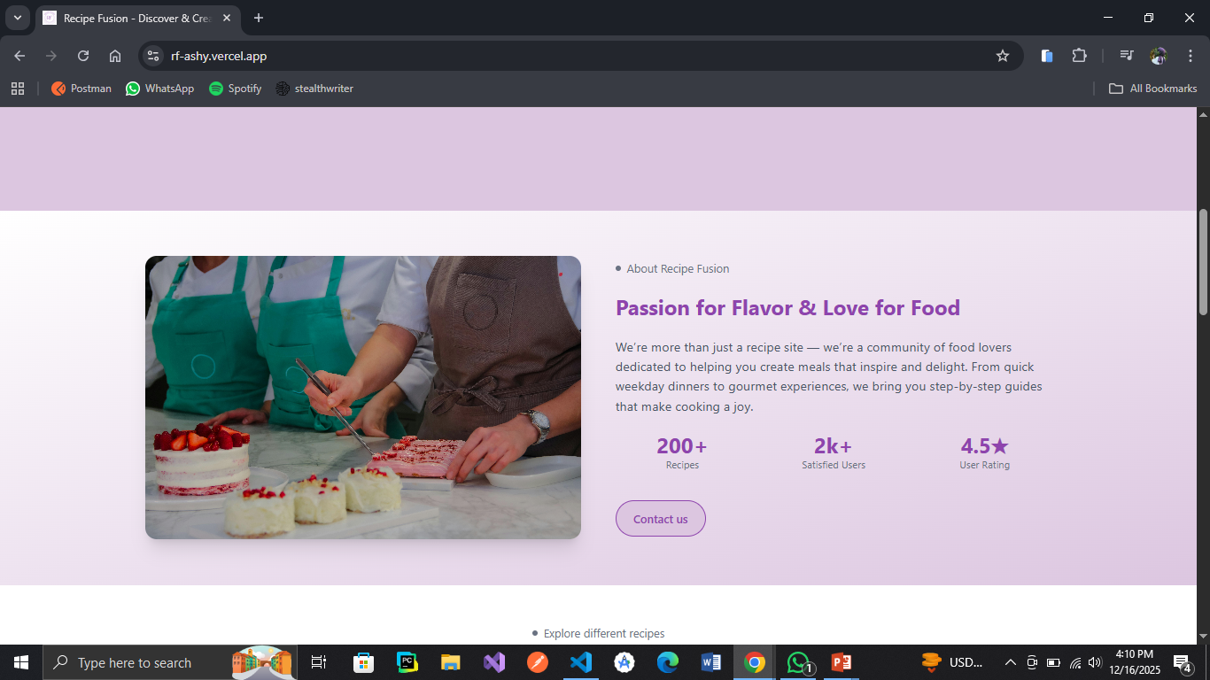
Landing Page
About Section

Slide 9
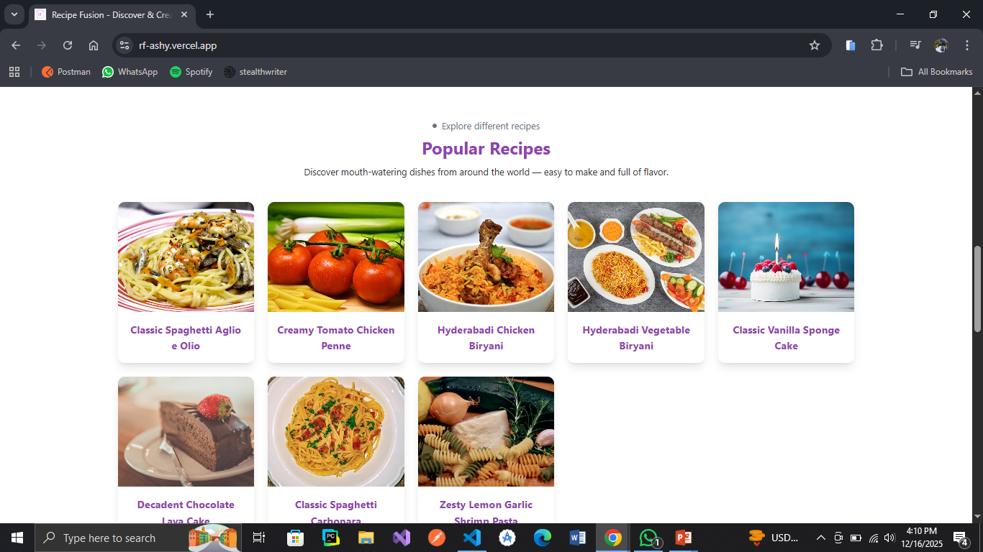
Landing Page
Popular Recipes Section

Slide 10
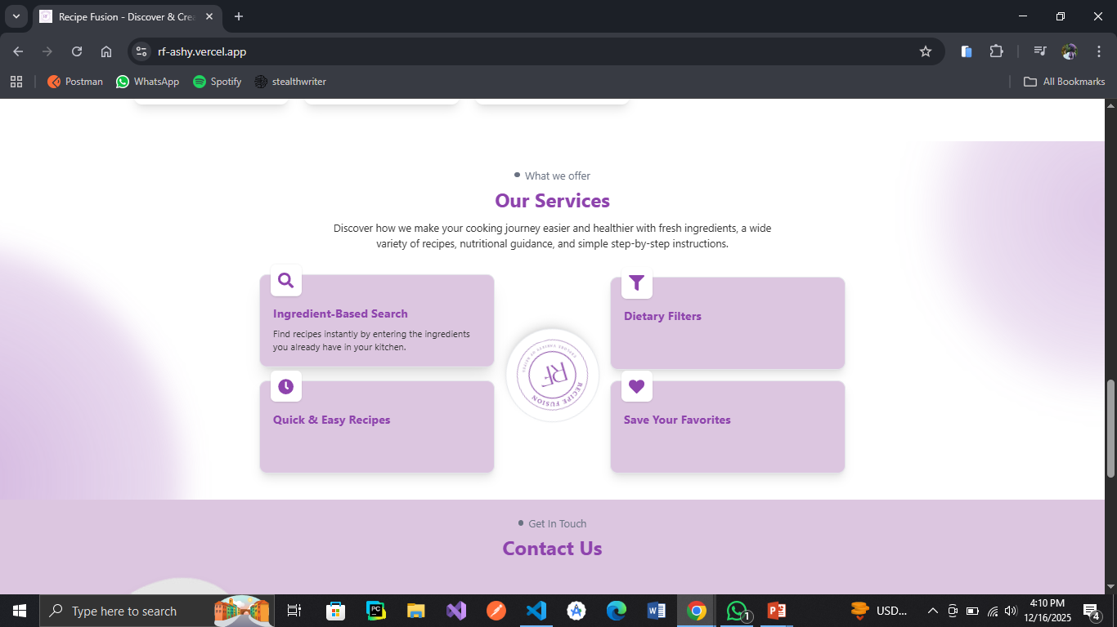
Landing Page
Services Section

Slide 11
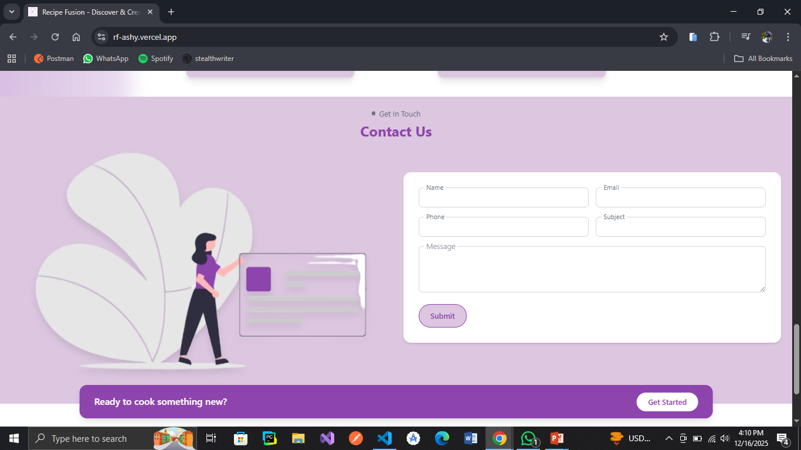
Landing Page
Contact Us

Slide 12
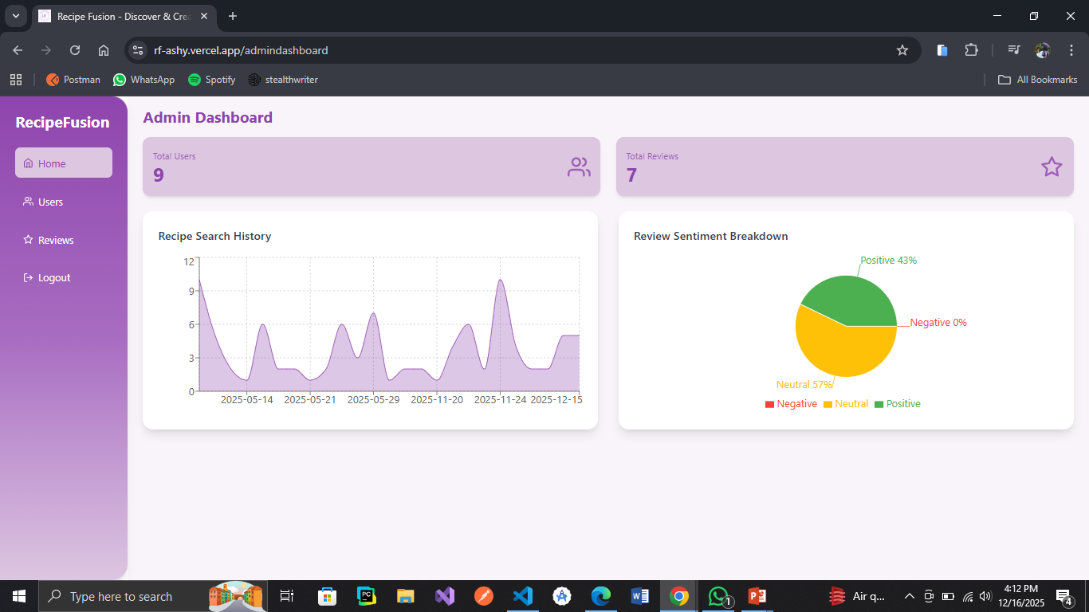
Admin Dashboard
Home Screen
Admin’s home screen shows the statistics of searched counts by users and sentiment analysis

Slide 13
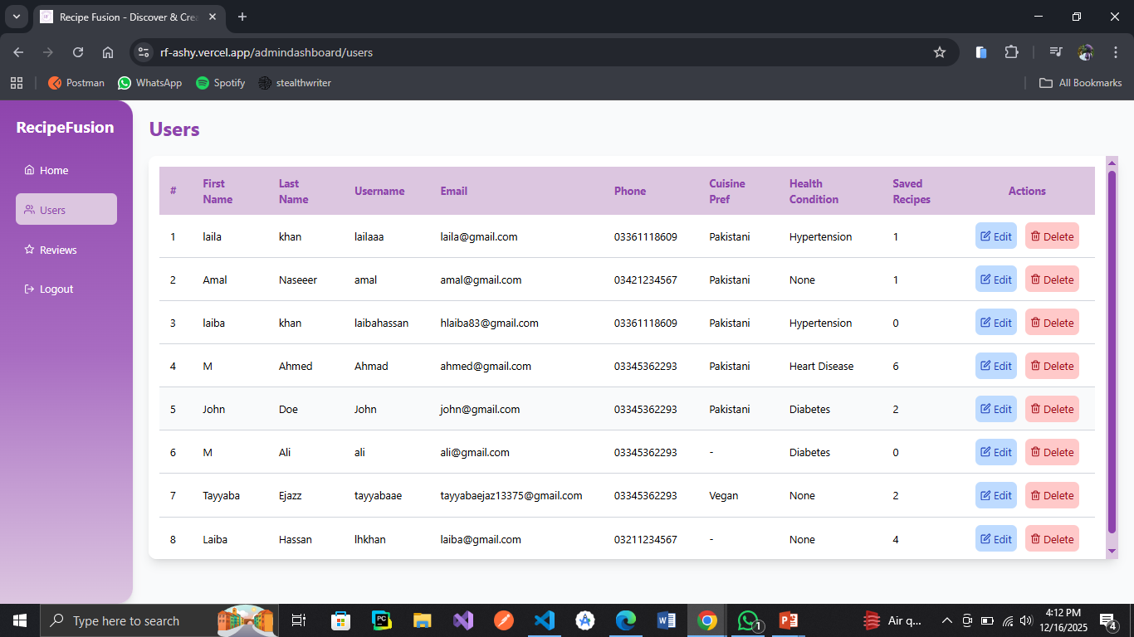
Admin Dashboard
All Users
There is a list of all the registered users. Admin can edit or delete any of the user

Slide 14
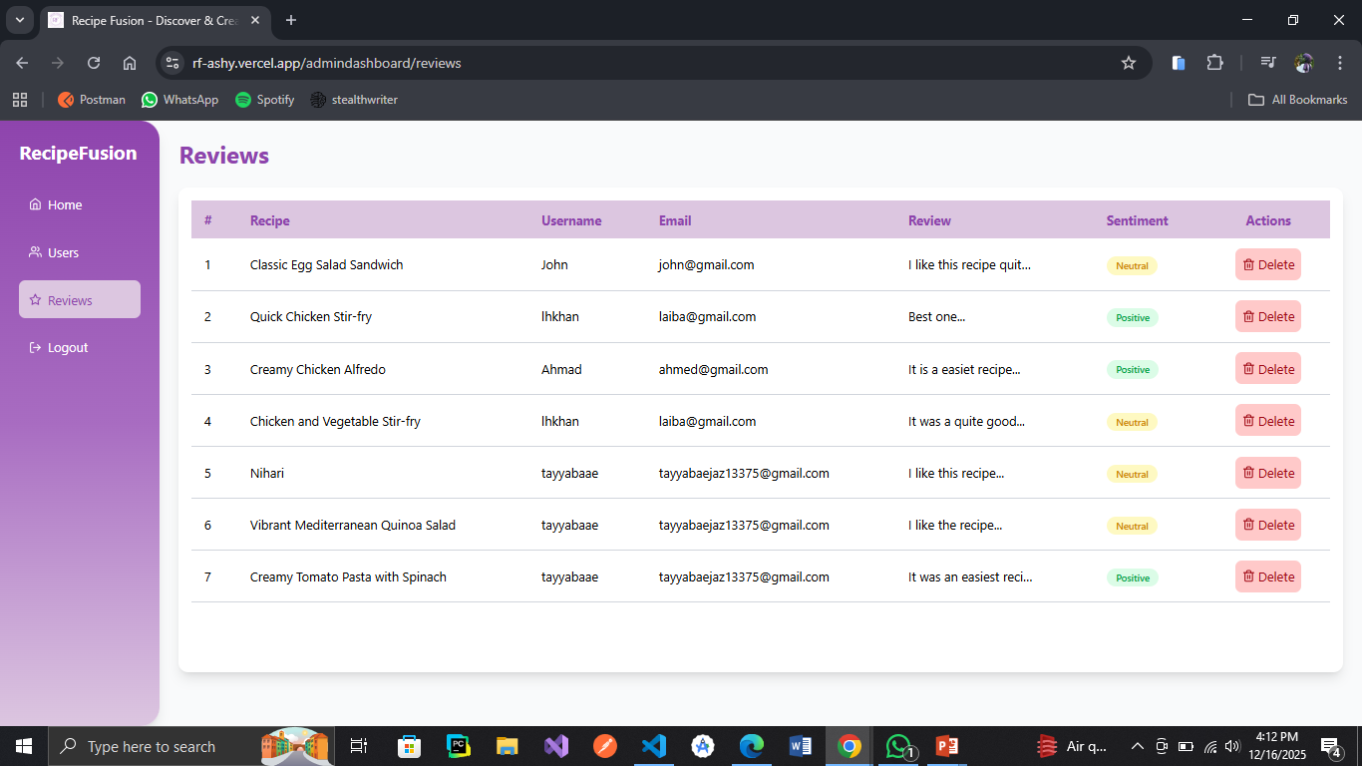
Admin Dashboard
Reviews
The reviews given by different users. Admin can remove any of the review if there is some issue, any review is offensive or anything else.

Slide 15
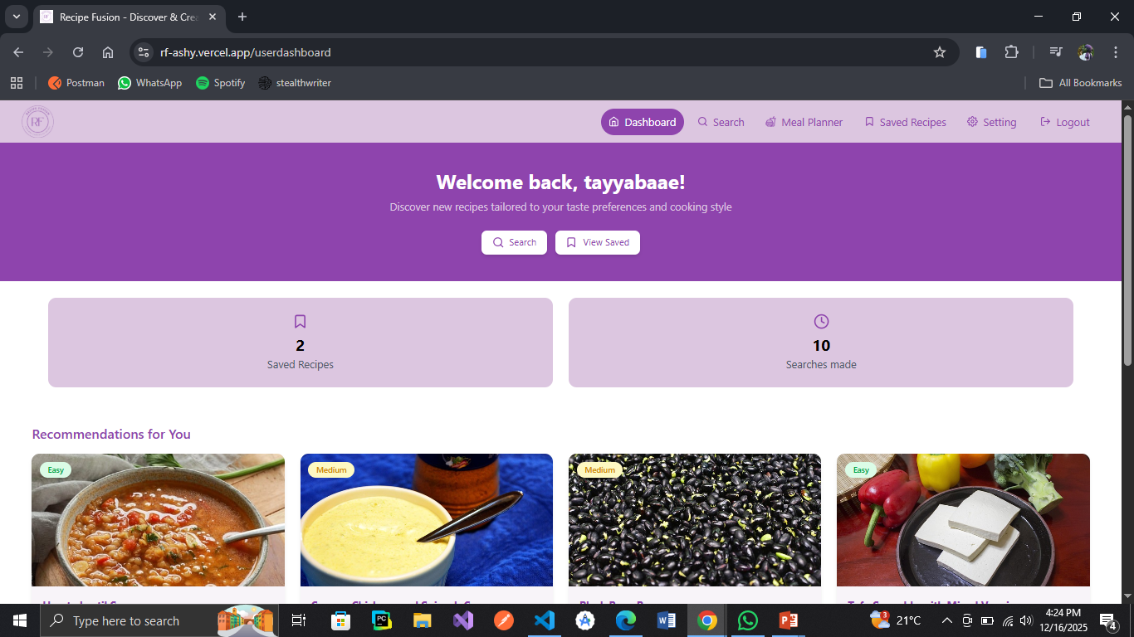
User Dashboard
Home Screen
User’s home screen which shows total recipes saved by user and searches made by him. Personalized recommendations for users are also shown on this page

Slide 16
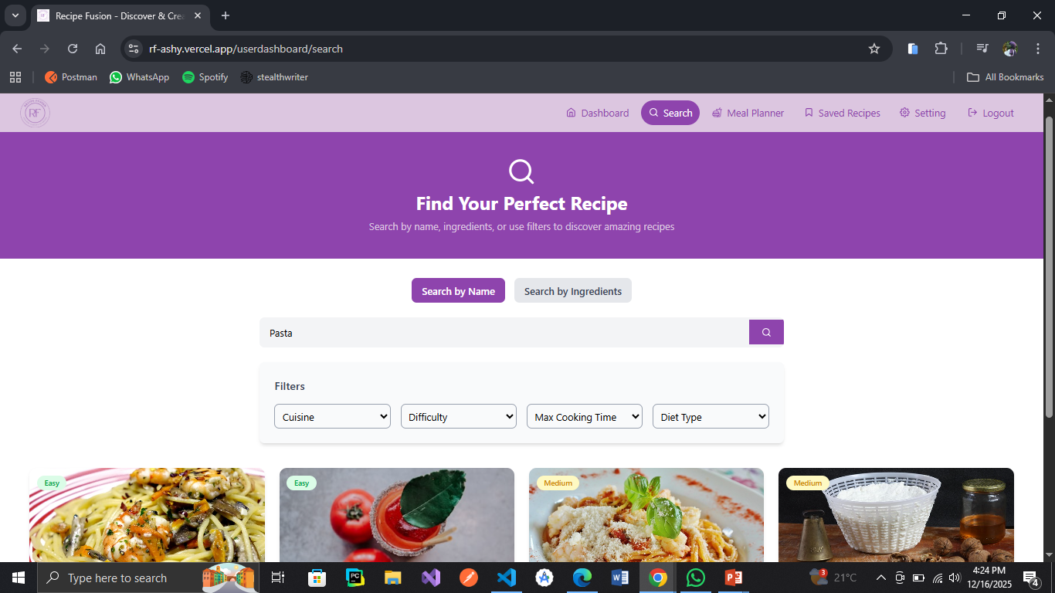
User Dashboard
Search Screen
User can search any recipe by it’s name or by entering available ingredients

Slide 17
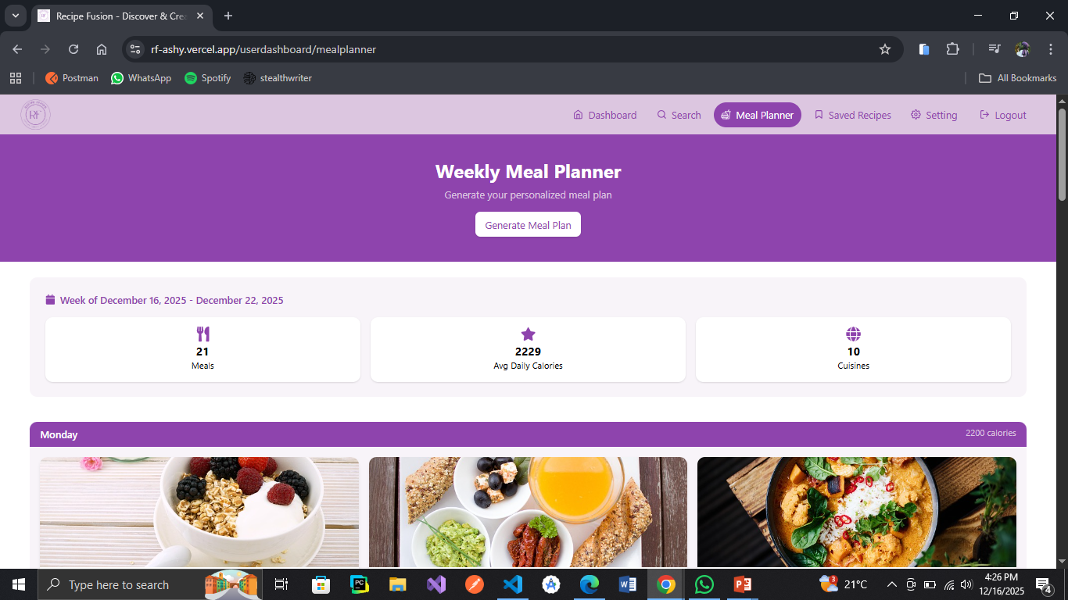
User Dashboard
Meal Planner
User can have a generated meal planner for a week which include breakfast, lunch and dinner

Slide 18
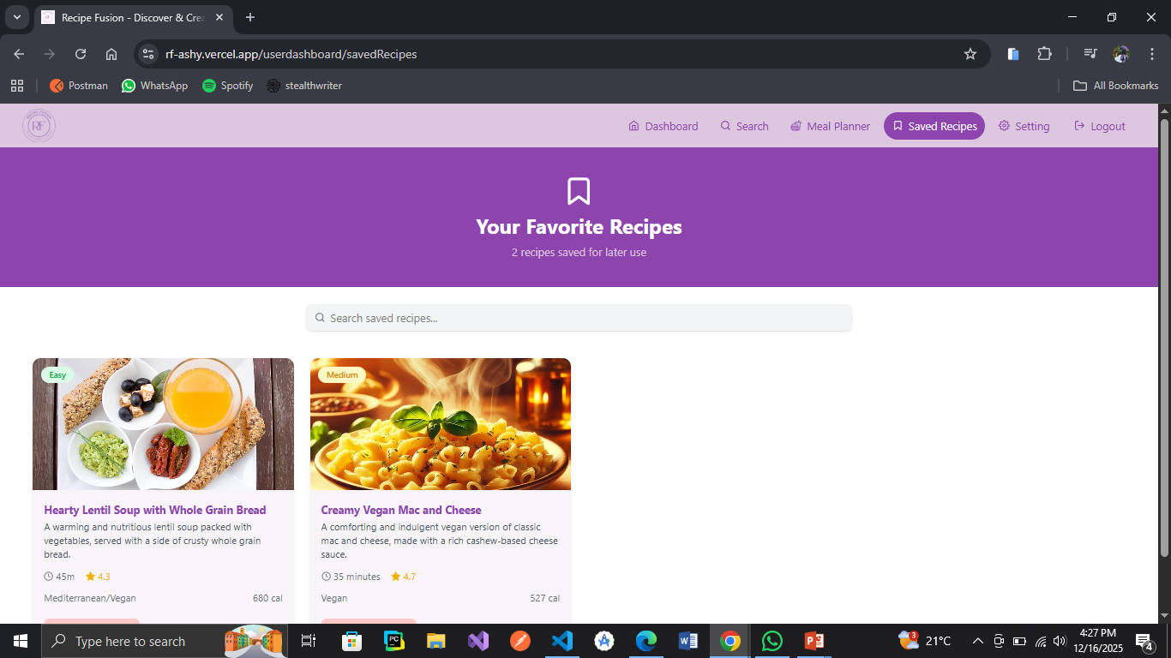
User Dashboard
Saved Recipes
The recipes saved by a particular user appear on this page the user can retrieve these whenever needed

Slide 19
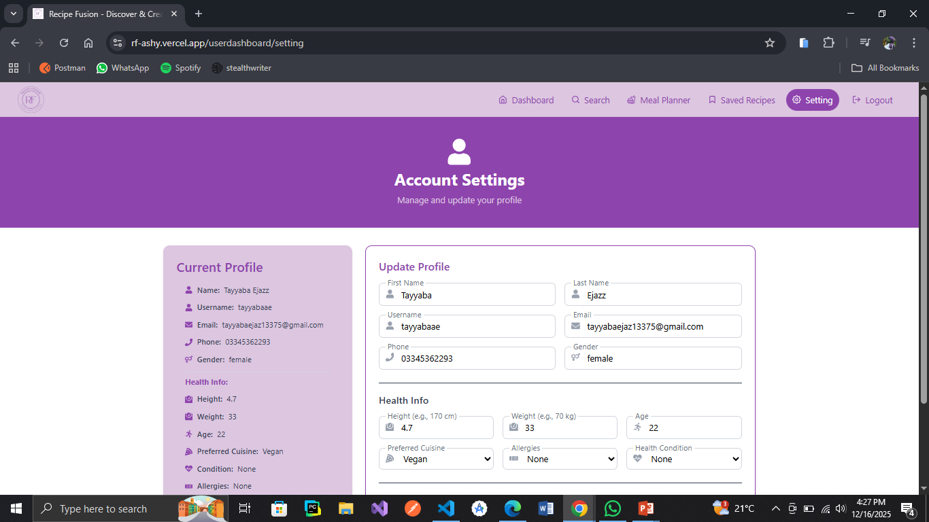
User Dashboard
Settings
User can update their profile in the setting page

Slide 20



SDG GOALS
2
Promotes access to nutritious meals by helping users discover recipes based on available ingredients.
12
Minimizes food waste by generating shopping lists and suggesting recipes based on what users already have
3
Encourages healthy eating habits through personalized filter

Slide 21
THANK YOU
Any Questions?

